Slide 1
PREDICTION OF DEPRESSION AND ANXITEY USING PHQ,GAD THROUGH ML
Takshak BS-4nm19cs203
Sumukh DN-4nm19cs197
Suhas Rao-4nm19cs196
Aditya VT-4nm19cs222

Slide 2
Problem Statement:
Mental health is a growing concern worldwide as more and more people are experiencing mental health challenges that negatively impact their daily lives.
Despite significant advances in understanding and treating mental health conditions, a significant number of individuals do not receive adequate support or treatment due to lack of resources, stigma, and limited access to mental health care services.
This results in a negative impact on individuals' quality of life, productivity, and well-being, as well as significant social and economic costs.
Thus, there is an urgent need to address mental health challenges and improve access to mental health care services to ensure better mental health outcomes for all individuals

Slide 3
MOTIVATION:
The growing mental health challenges faced by individuals worldwide and the significant negative impact they have on their daily lives, productivity, and well-being motivate the need for urgent action to address this issue.
Despite significant advances in mental health understanding and treatment, limited access to mental health care services, stigma, and lack of resources continue to prevent individuals from receiving adequate support and treatment.
By improving access to mental health care services, we can promote better mental health outcomes for individuals and society as a whole, leading to improved quality of life and reduced social and economic costs

Slide 4

Objectives
To provide an overview of the current state of mental health of a user using PHQ and GAD
To provide recommendation based on the score and level to the user.
The recommendations given to the user should help them to decrease the depression and anxiety score and level over the period of time.
To provide the sentiment analysis score for the content written by the user.
To provide the graphical representation of the PHQ and GAD scores of the user.

Slide 5
Research Findings
Research suggests that mental health disorders are strongly influenced by social determinants such as poverty, discrimination, and social isolation.
There is a growing body of evidence that suggests that early intervention and prevention programs can reduce the burden of mental health problems.
Access to mental health services is a major issue in both low- and high-income countries, with stigma and lack of resources being major barriers.
Mental health promotion and prevention programs in schools and workplaces can have a positive impact on mental health outcomes.

Slide 6
Existing Solution
Psychotherapy
Medication
Cognitive Behavioral Therapy (CBT)
Dialectical Behavior Therapy (DBT)
Electroconvulsive Therapy (ECT)

Slide 7
Methodology Used
PHQ-9
It is referred to as a Patient Health Questionnaire(PHQ) and it is a series of questions that the user needs to answer to determine the mental health of the user. It has 9 questions, which are used to gauge the severity of depression and for other purposes
GAD-7
Generalized Anxiety Disorder(GAD) has a set of seven questions that the patient must respond to. It has seven questions, and these are intended to evaluate the patient's level of anxiousness severity.

Slide 8
SENTIMENT ANALYSIS OF TEXT
Another strategy we employ is analyzing the patient's text diaries in order to determine how the patient feels about themselves. Here, we are performing sentiment analysis and computing the sentiment score, which is then used to determine the patient's severity level and the appropriate course of treatment.
LINEAR REGRESSION
The relationship between a dependent variable and one or more independent variables can be modeled statistically using linear regression. It employs a line to illustrate the relationship between the variables, presuming that it is linear.

Slide 9
Workflow
Login feature with Signup, Sign-in
Phq-9 questioner to determine the current depression level/state.
GAD-7 questioner to determine the current anxiety level/state.
Users can see their mental progress in terms of a graph
According to the report activities are suggested to improve their mental health condition.
Journal feature detects mental health of a person through sentiment analysis of text.
Emotional state of users are calculated by using some questionnaires asked in the site and user need to answer that. In this way we can predict mental health of user and we can assign task
At the end we also provide some psychologist contact details they can contact them through video or through chat

Slide 10
System Design

Slide 11
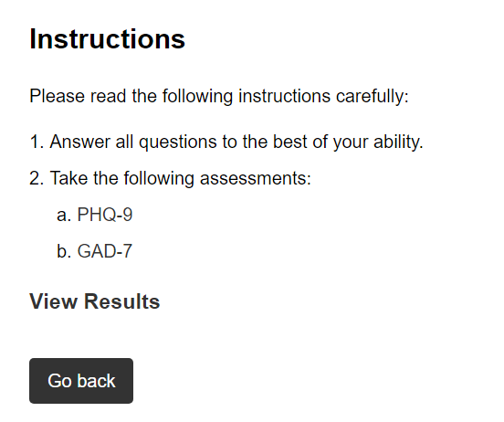
DATA COLLECTION
DATA COLLECTION WILL BE DONE THOUGH WEBSITE .
DATASET WHICH ARE REQUIRED FOR ANALYSING DEPRESSION AND ANXIETY WILL BE FETCHED FROM USER'S AND THEN IS GIVE AS INPUT TO LOGISTIC REGRESSION ALGORITHM.

Slide 12
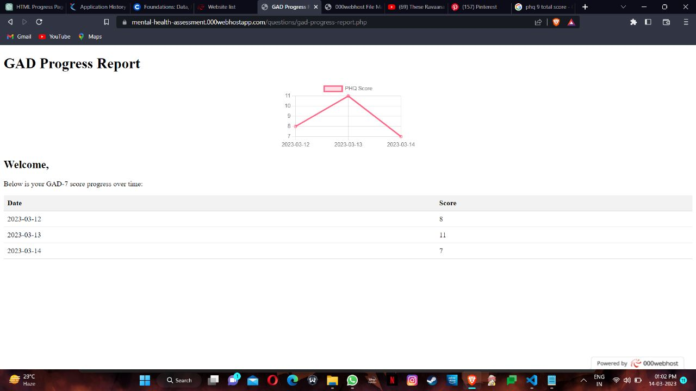
Data Analysis
Collection of weekly Data from Participants.
The Collected data will be analyzed and represented as report in the form of graph.
According to the severity recommendation are done.

Slide 13
Algorithms Used
Linear regression.
Sentiment analysis of text using textblob.

Slide 14

Recommendations
Meditation
Meditation has numerous benefits for mental health.
Reduce stress and anxiety
Improve focus and attention.
Boost mood by increasing serotonin levels
Increase self-awareness
Improves sleep quality

Slide 15

Recommendations
Games
There is growing evidence to suggest that playing games can have a positive impact on mental health. Here are some ways that games can be beneficial:
Helps in Reducing stress
Helps in Boosting mood
Helps in Building social connections

Slide 16

Diary Writing
Diary writing is a form of expressive therapy that has been used to treat mental depression for many years.
Helps in Emotional release
Helps to calm mind

Slide 17
Conclusion
Analyzing the scores of GAD and PHQ to get the level of anxiety and depression of the user and providing the user a better mental health.

Slide 18
Future work
Additional screening tools,
Personalizing recommendations,
Integrating wearable technology,
Implementing chatbots
Improve accuracy
Expanding the user base to employers and healthcare providers could improve employee well-being

Slide 19


